Slide 1

Augmented Reality: When the Digital World Meets the Real World
Blending the physical and digital into one seamless experience

Slide 2

The AR You Already Use Every Day
Snapchat
Filters transform your face in real-time
Instagram
Try on makeup and accessories virtually
TikTok
Immersive visual filter experiences
The Core Idea
AR adds digital elements directly to your real world

Slide 3

How AR Works: The Technology Behind the Magic
Capture
Tracking
Vision
Mapping
Render

Slide 4




AR in the Real World: Where It's Happening Now
Gaming
Shopping
Healthcare
Automotive
Pokémon GO, Minecraft AR — catch creatures in your neighborhood
Try furniture at home before buying, virtual try-ons
Surgeons use AR for precision during complex operations
Head-up displays show navigation and vehicle data

Slide 5
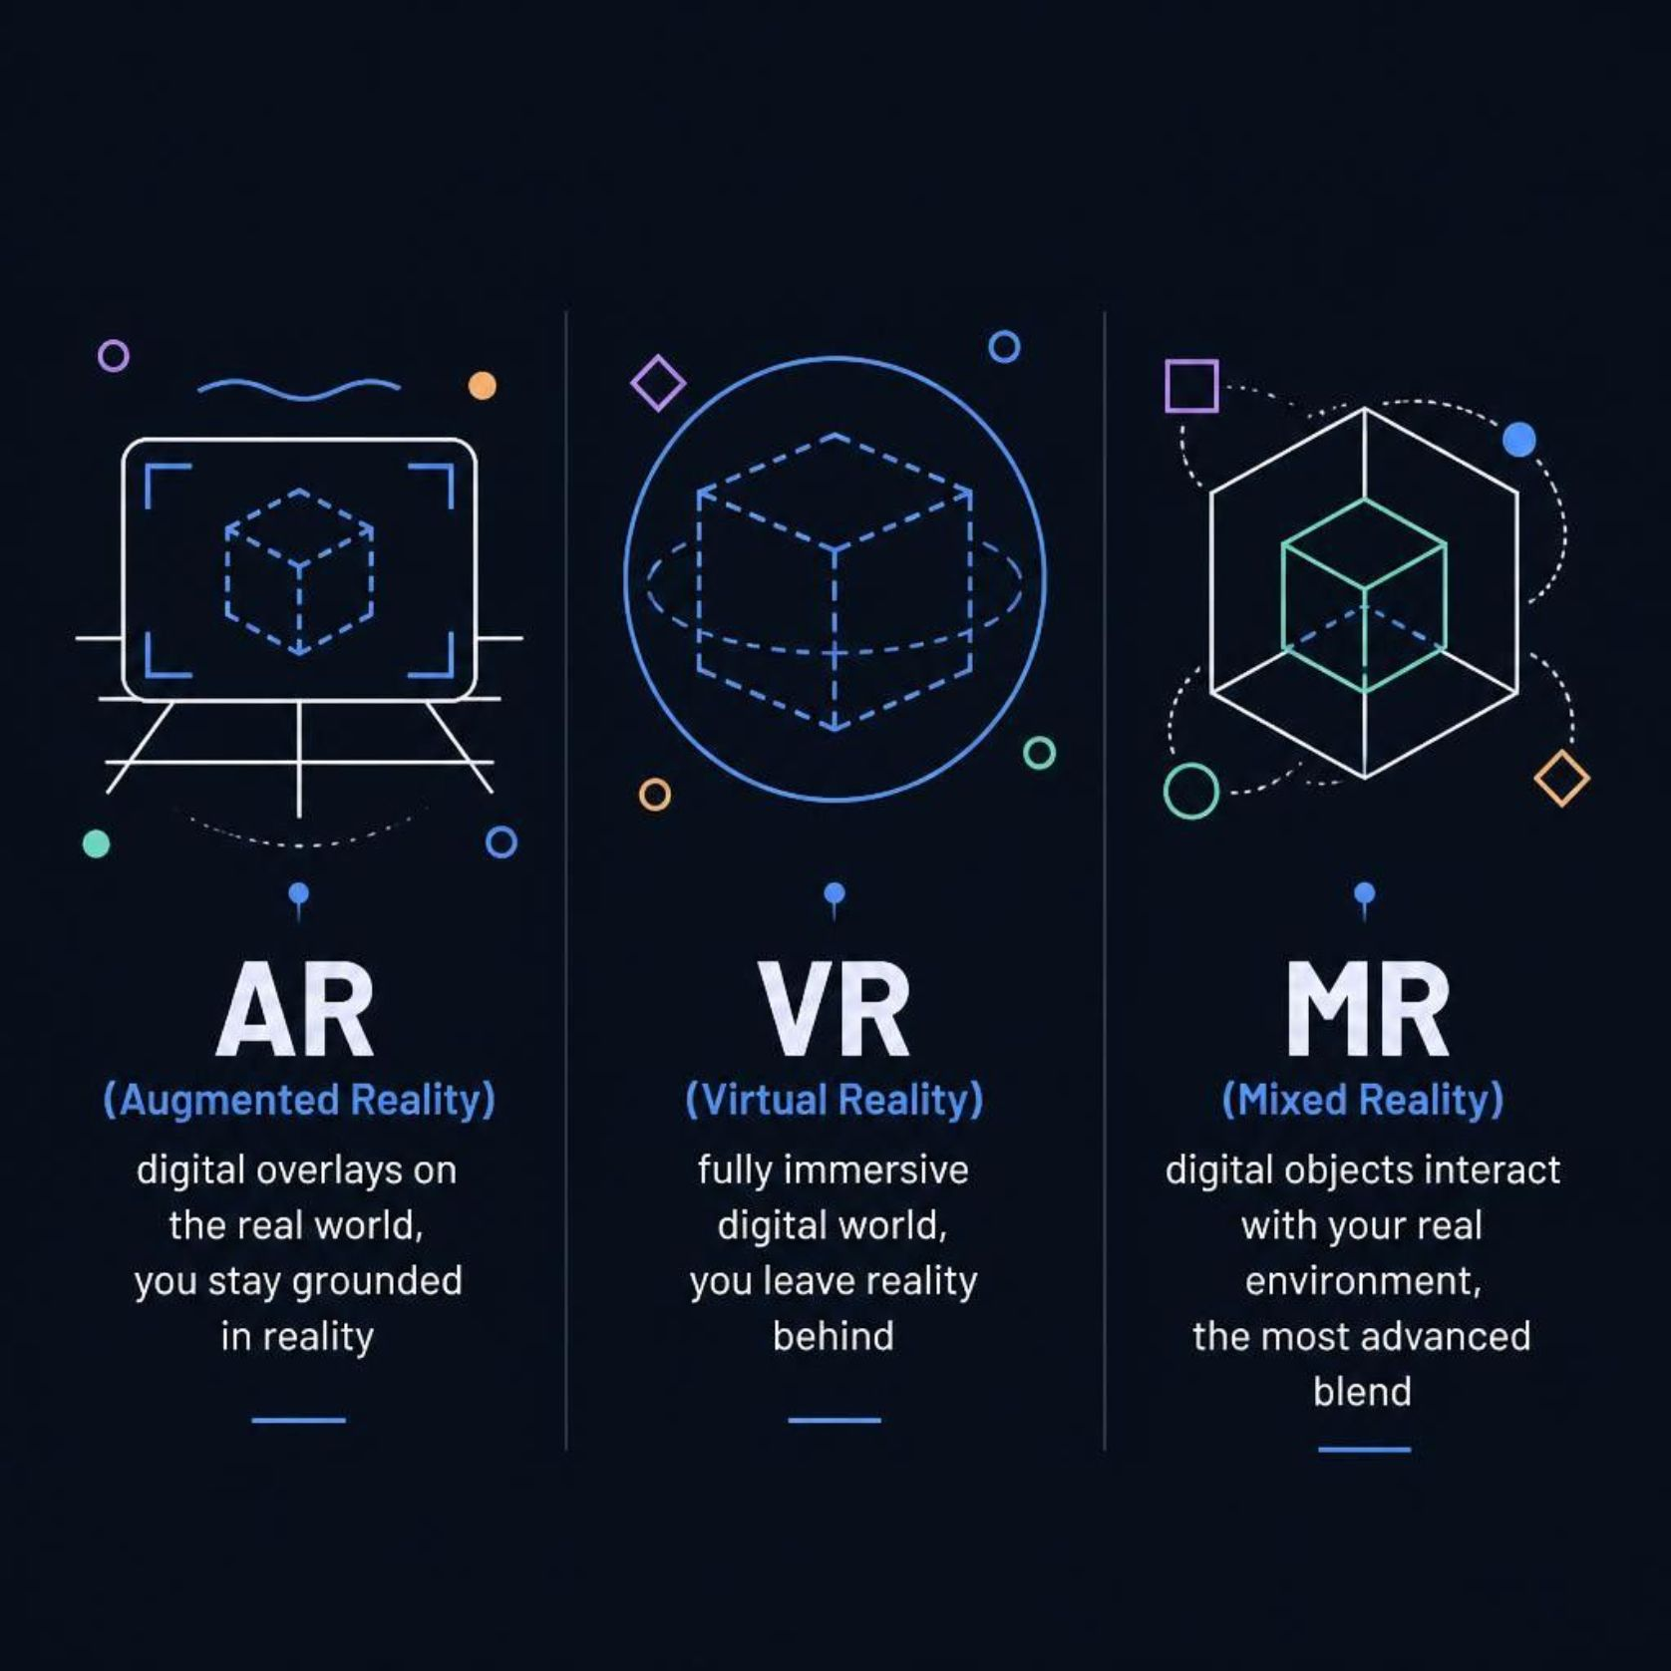
AR vs VR vs MR: Understanding the Spectrum
AR — Augmented Reality
Digital overlays on the real world — you stay grounded in reality
VR — Virtual Reality
Fully immersive digital world — you leave reality behind
MR — Mixed Reality
Digital objects interact with your real environment — the most advanced blend

Slide 6

Why AR Matters: Advantages & Challenges
Advantages
Challenges
Enhances real-world experience
Hands-free interaction
Practical, everyday applications
Accessible via smartphones
Battery drain & processing limits
Privacy concerns
Need for better hardware
User adoption barriers

Slide 7




The Future of AR: What's Coming Next
AR Glasses
Education
Navigation
Everyday Life
Lightweight, always-on devices replacing smartphones
Interactive 3D models for anatomy, history, and science
Real-time directions overlaid on streets and buildings
AR becomes as natural as looking at your phone — woven into how we work, shop, and connect

Slide 8

AR is Making the Real World More Interactive
Digital information blends seamlessly with your physical environment
The boundary between digital and real continues to blur
AR is not the future — it's happening now
The question isn't "if" — but how will AR change your world?

